Slide 1

Plug-in Electric Vehicle Sales using SAC

Slide 2







Johanna Albarracin. Nora Collins. Rick Gonzalez. Julie Gutierrez. Ferez Khavari an. Luis Martinez. Jamie Westby.
Group 4

Slide 3
DATA SOURCES
Alternative fuels data center, Tesla Company, International Energy Agency
Software: SAP Cloud Analytics
DATA SIZE
Total data size 320 MB
Base years: 2019 2021 2022 2023
SAC link:
https://higher-education.us10.sapanalytics.cloud/sap/fpa/ui/tenants/81639#view_id=contentLib;resourceId=746C4282F3662CFAD649773D53945896;resourceType=FOLDER
Notes:
Creation on file in SAP that was shared in a file called Group 4 with all the group members
https://www-statista-com.mimas.calstatela.edu/search/?q=EV+purchase+likelihood+in+the+U.S+by+consumer+age+group+2021&Search=&qKat=search&newSearch=true
Number of Tesla locations in the USA in 2023 | ScrapeHero
Data Source: afdc.energy.gov ( Alternative fuels data center)
https://www-statista-com.mimas.calstatela.edu/statistics/1305918/us-transportation-co2-emissions-projections-by-fuel-type/?locale=en
https://www.iea.org/data-and-statistics/charts/number-of-available-electric-car-models-by-type-and-region-2021

Slide 4
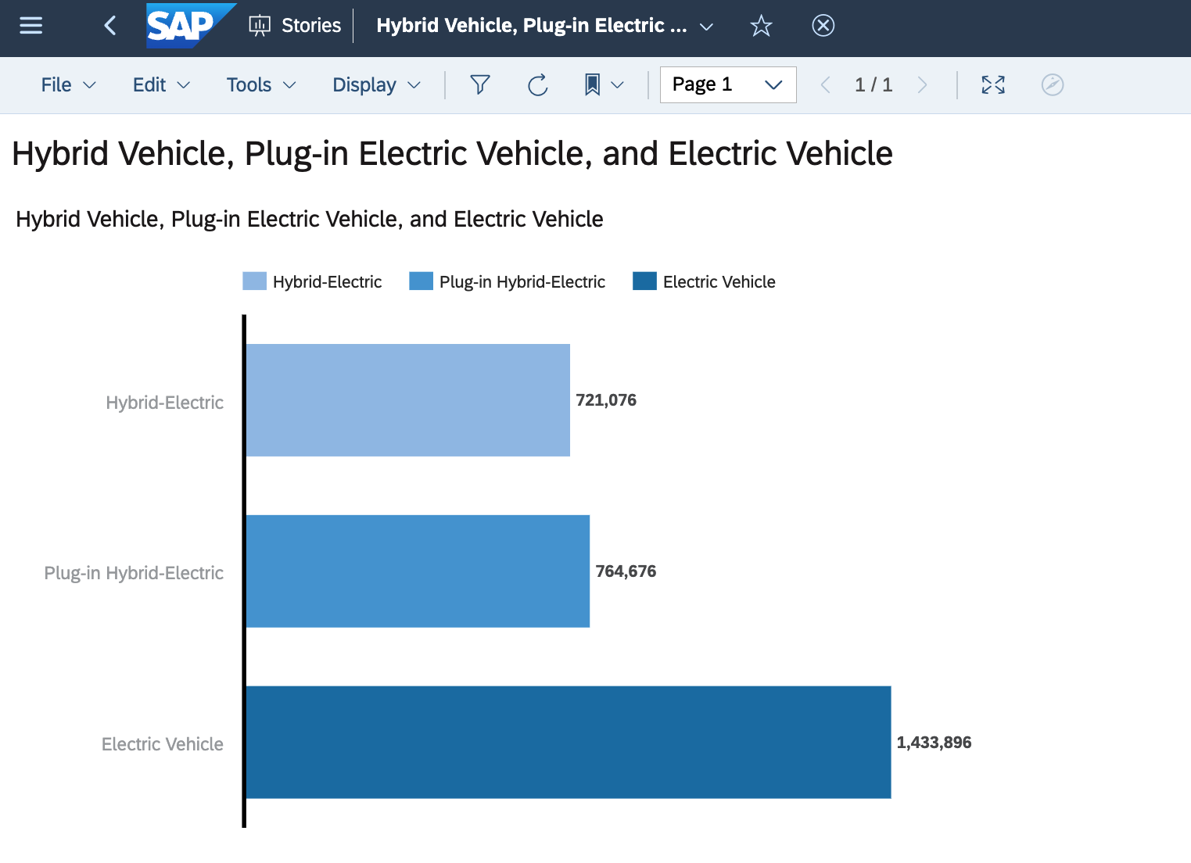
Electric vehicles are taking the U.S market industry by storm
Notes:
In this bar graph, it shows the different EV cars.
Hybrid Electric @ 720,000
Plug-in Hybrid Electric @ 7650,000,
&& All Electric Vehicles at over 1.4 million
As you can see, ALL Electric Vehicles has the biggest percentage in the U.S market.
Hybrid= the internal combustion engine with electrical power produced by an on-board electric motor.
Plug-in= haver a larger battery than a conventional hybrid car, and is charged by plugging into an electric outlet.
Fully electric= does not have a gasoline or diesel engine and instead has an electric motor, power electronics, and a battery pack.
Compared to plug-in hybrids, electric vehicles have many advantages. Majority buyers are drawn to electric vehicles because they are better for the environment than plug-in hybrids.

Slide 5
Tesla Model Units Sold Per
Midsize Luxury Vehicles
Tesla has highest new vehicle registration for 2022.
Tesla is considered the sole market leader in the midsize luxury market with 195,698 registrations (up 59% in one year).
Lexus ES is behind Tesla Model 3 with 41,465, followed by BMV 5 Series with 20,857.
Lexus GS and Jaguar were the lowest with 2 and 809 respectively.
Notes:
One of the highest electric vehicles is Tesla

Slide 6
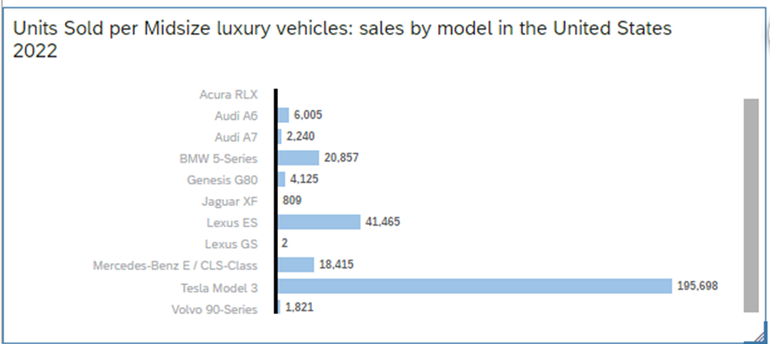
Tesla Model Units Sold Per
Midsize Luxury Vehicles
Notes:
As you can see in this graph Tesla of the models with most sales in 2022 in the unites states, followed by Lexus ES

Slide 7
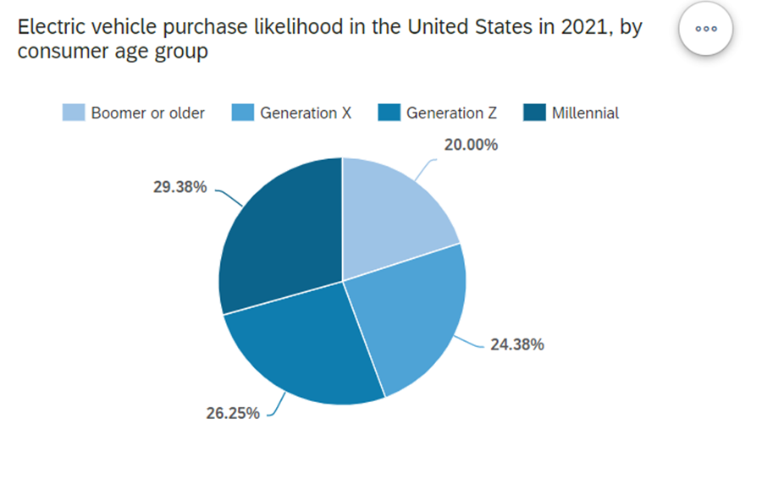
EV purchase by consumer age group
Millennial drivers are at the forefront of the electric car trend ​
There are several reasons why millennials are choosing to drive electric vehicles. ​
Electric cars are much more environmentally friendly than gasoline powered cars. ​
Electric cars often have an overall lower cost of ownership than petroleum fueled cars. ​
Gen Z's primary interest is because EV’s are viewed as "cool and hip" to drive. ​
Baby Boomers are the least likely to show an interest in buying an Electric Vehicle.​
Notes:
According to the research represented in this pie chart graph, millennial drivers are the forefront of the electric card trend

Slide 8
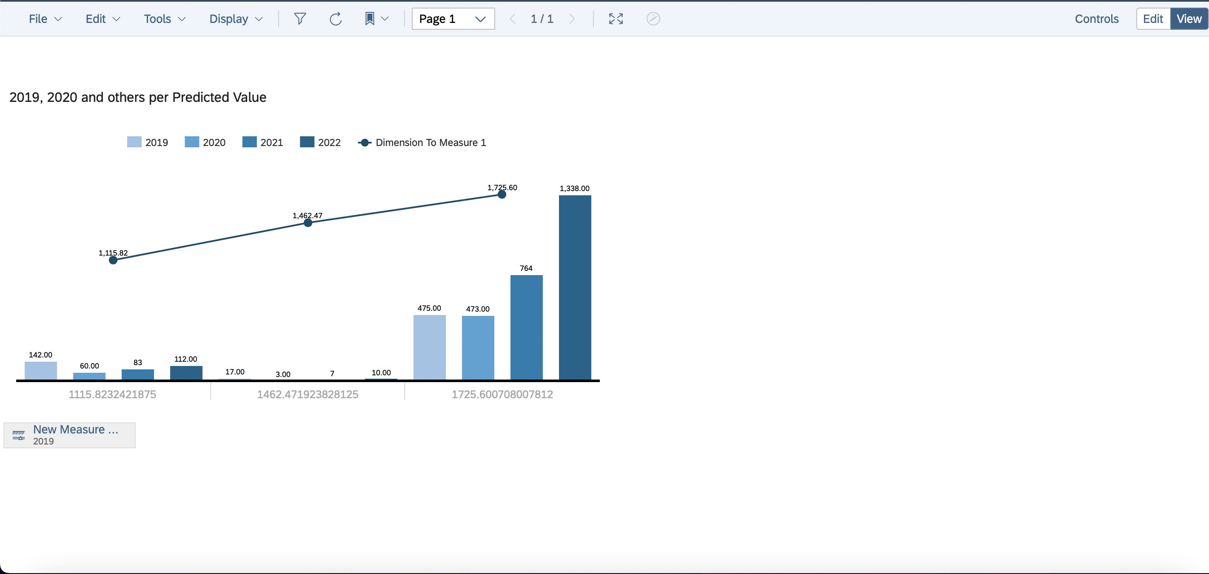
Fuel Technology type with the most incentives
Notes:
According to the law and incentive additions in the United States electric vehicles are the car with the most incentives in the US. Being year 2022 the one with the most rewards. The data came from the Alternative Fuels Data center describing different types of technology available per fuel type out of 16 fuel types of fuel including Aftermarket Conversion3 Biodiesel Blends Connected and Autonomous Vehicles5 Efficiency Electric Vehicles6 Emissions Ethanol Hybrid Electric Vehicles Hydrogen Idle Reduction Natural Gas Neighborhood EVs7 Renewable Diesel Other Propane .

Slide 9
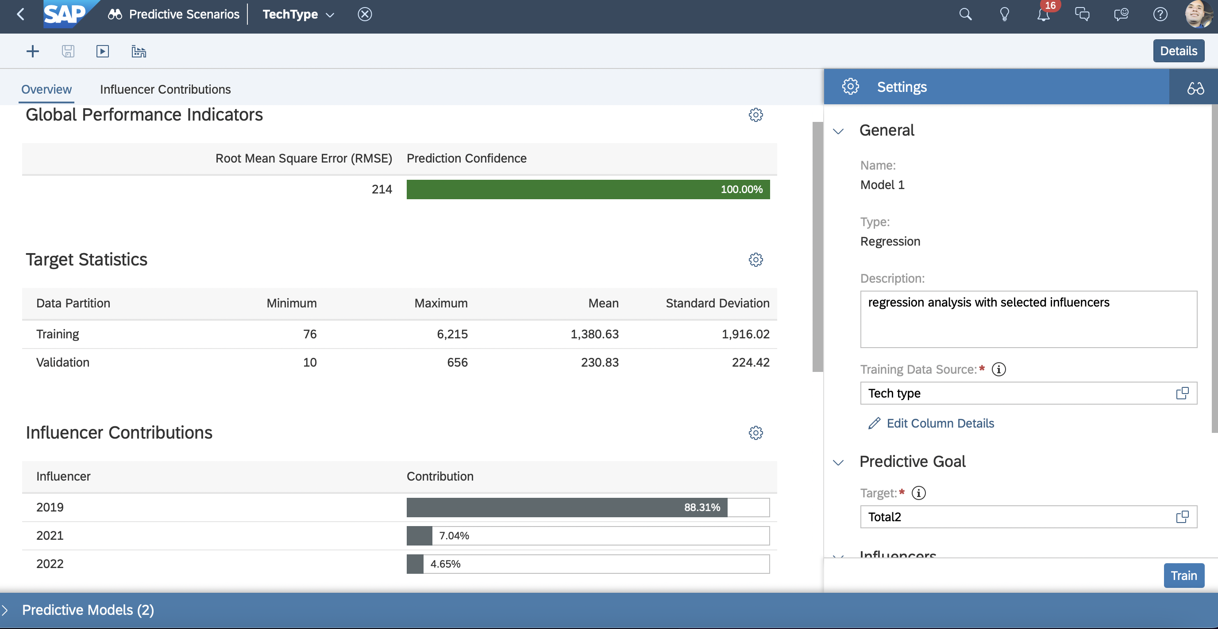
Fuel Technology type with the most incentives
Notes:
The prediction confidence for this model is 100%, we predicted the number with the fuel type with the most incentives

Slide 10
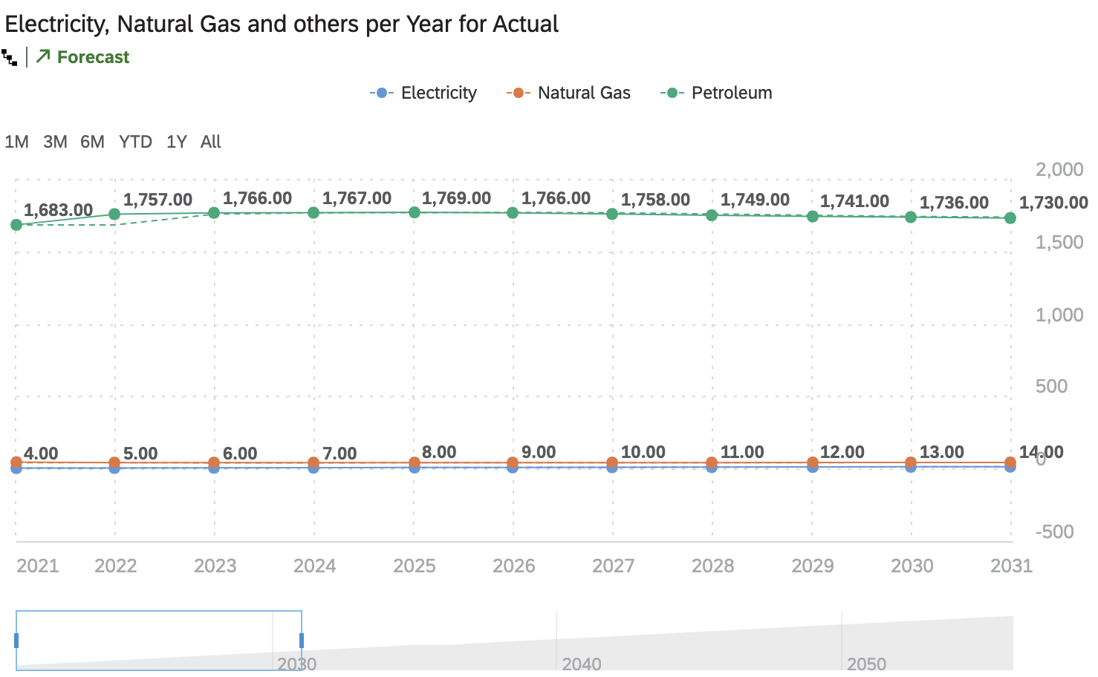
Impact on Environment
Predicted CO2 emissions in the United States by fuel type (in million metric tons)
Notes:
The graph below shows the time series analysis and forecast of CO2 emissions (in million metric tons) predictions in the United States from 2021 to 2031. Electricity, Natural Gas, and Petroleum are represented. The graph shows a gradual increase in total fuel type emissions. Petroleum has the highest levels of CO2 released into the atmosphere and Electricity contributes the least amount. As the transition to electric vehicles is encouraged through various incentives and associated benefits, it is predicted that Petroleum emissions will eventually decrease. Based on the data, purchasing a Tesla Model 3 will contribute greatly to the reduction of CO2 emissions overtime. According to Tesla, current energy trends remain stable. The emissions generated from electric vehicles are expected to decline over time with the addition of greener energy resources.

Slide 11
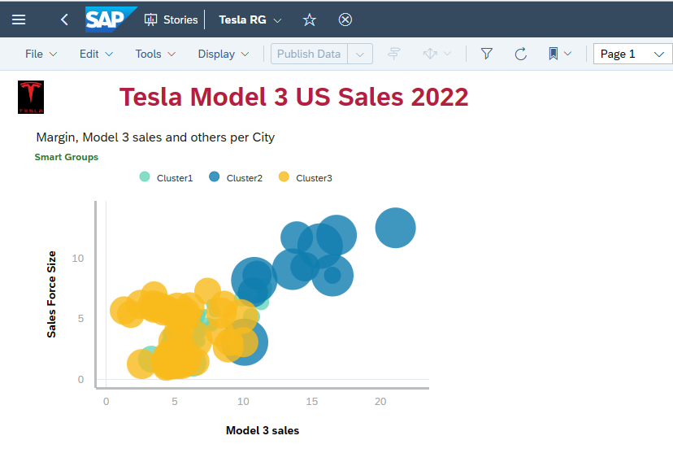
Increased Demand for Hybrid Cars
Notes:
• Import and prepare data. • Apply Smart Grouping cluster analysis. • Create data visualizations. • Analyze and interpret output from models. Cluster 1,2 & 3 represent increased sales of Tesla Model 3 in the last quarter of 2022 and beginning of 2023, by city, state and dealership in the country.
Final numbers have not been reported yet, as we are still in the first Quarter of 2023. Clusters are scattered according to state, city and Official Tesla dealership in the US. Last quarter of 2022 estimates sales reported 57600 model 3.
Importance of clustering data miming:
To Apply Smart Grouping cluster analysis. • Create data visualizations to aid decision makers in their industry • Analyze, interpret and adjust output from clustering models.
Analyzing data using cluster modeling tools help analyze, predict and determine where the strongest areas of sales occur, and help determine areas of opportunity for marketing management, and operations directors to focus their resources to increase sales.
When working with dataset, organizing it into significant groups is a fundamental and effective approach to data mining and data analysis. Clustering classifies samples into groups using a measure of association so that data points within a group are similar. Data points from different groups are not similar. Data points are multidimensional, that is they consist of several variables, such as location, demographics, salesforce, marketing and other important determinants. Visualization is not practical for humans when datasets consist of more than three dimensions, that is why we use K-Means clustering which help segment different areas of data mining. The input to a clustering exercise is a dataset and the number of clusters. The result of the analysis is a set of clusters. K-means clustering is a method of finding clusters and their centers (R) given a choice in the number of clusters (K). It is often used for market segmentation. The goal is to make the inter-cluster difference (distance) high and the intra-cluster difference (distance) low.
Import and prepare data. • Apply Smart Grouping cluster analysis. • Create data visualizations. • Analyze and interpret output from models. Cluster 1,2 & 3 represent increased sales of Tesla Model 3 in the last quarter of 2022 and beginning of 2023, by city, state and dealership in the country.
Final numbers have not been reported yet, as we are still in the first Quarter of 2023. Clusters are scattered according to state, city and Official Tesla dealership in the US. Last quarter of 2022 estimates sales reported 57600 model 3.
These graphs represent highest number of sales of Tesla Model 3 in the major cities of the US, according to the scattered clusters #1, #2 & #3 in the previous slide. We can conclude that the Tesla Model 3 is the Iconic vehicle which.
accounts for a significant percentage of Tesla profitability. From the year of inception in 2015 Model 3 was not a popular or iconic as it did not record any sales until to 2018 with 93000 vehicles sold, from there on Model 3 became an iconic competing EV competing with Toyota and other high-end vehicles, such as BMW among others.
2017= 2320
2018=93k
2019=126k
2020=158k
2021=121,610
2022=240,266

Slide 13
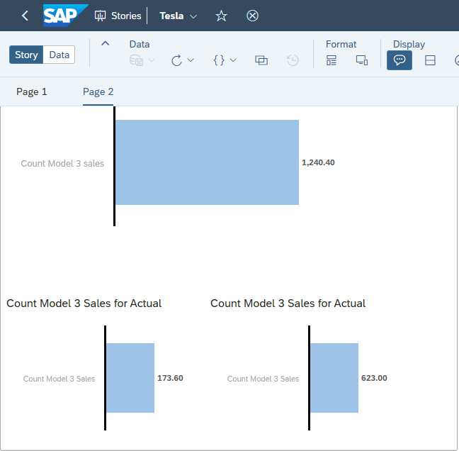
Increased Demand for Hybrid Cars
Notes:
Analyzing data using cluster modeling tools help analyze, predict and determine where the strongest areas of sales occur, and also help determine areas of opportunity for marketing management, and operations directors to focus their resources to increase sales.
These graphs represent highest number of sales of Tesla Model 3 in the major cities of the US, according to the scattered clusters #1, #2 & #3 in the previous slide. We can conclude that the Tesla Model 3 is the Iconic vehicle which accounts for a significant percentage of Tesla profitability. From the year of inception in 2015 Model 3 was not a popular or iconic as it did not record any sales until to 2018 with 93000 vehicles sold, from there on Model 3 became an iconic competing EV competing with Toyota and other high end vehicles, such as BMW among others.

Slide 14
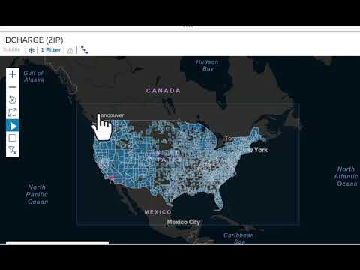
EV Charging stations in the US
Notes:
According to the geo map..... the state of California is the one with the most charging stations........ the region with the most charging stations is Los Angeles followed by San Francisco and San Diego.

Slide 15
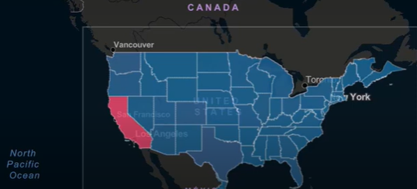
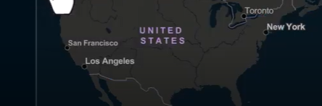
EV Charging stations in the US
Notes:
According to the geo map..... the state of California is the one with the most charging stations........ the region with the most charging stations is Los Angeles followed by San Francisco and San Diego.

Slide 16
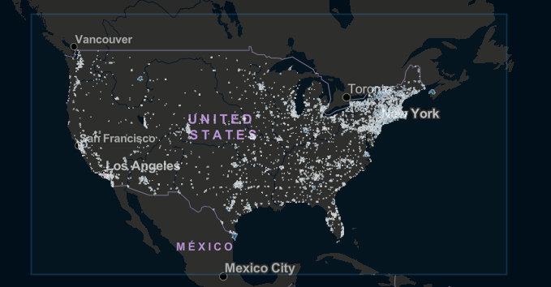
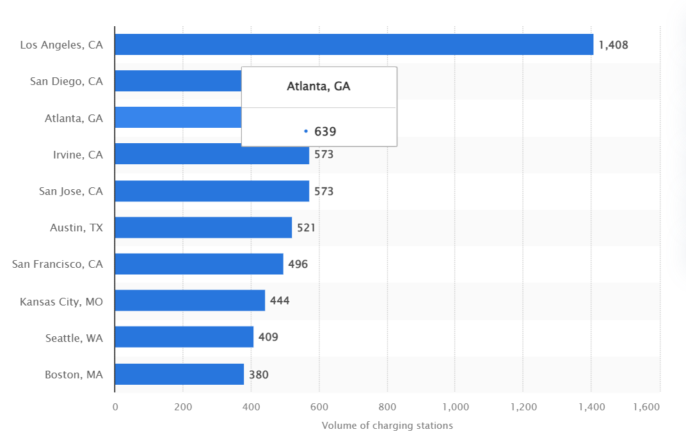
Cities with the most charging stations in the US
Notes:
We also can see with a different view the accumulation on stations on the east coast. And none in the mid west. (Alternative fuels data center)

